Slide 1
Sociology: 3549 ANOVA
Recitation #12
Yue Chu

Slide 2
announcement
Homework 4 has been distributed.
Free Stats tutors – Peter and Lesley
https://osu.zoom.us/j/98745192052?pwd=WTUydnRsSlQ3bDhpY291MGFCWkJsdz09
Meeting ID: 987 4519 2052; Password: 647076
Mondays: 12:30 - 3:30 pm
Tuesdays: Noon - 4 pm
Wednesdays: 9:30 am - 12:30 pm
Thursdays: 10 - 11 am and Noon - 4 pm
Fridays: 9:30 am - 2:30 pm

Slide 3
agenda
Review of lecture
Activity
One-way ANOVA
In class exercise
Upload your answer to Carmen for today’s lab attendance

Slide 4
Hypothesis testing
Association between two variables: whether two variables vary together
E.g. test score between genders, birth weight between birth cohorts
Independent vs dependent variable
Independent var. (IV): variables unaffected by other variables being measured
Dependent var. (DV):variables depending on other factors being measured
Association ≠ Causality
Association is one of the criteria for causality, but not sufficient
Temporality; Theoretical plausibility; Nonspuriousness; Consistency;…
Notes:
Causation
https://www.sagepub.com/sites/default/files/upm-binaries/23639_Chapter_5___Causation_and_Experimental_Design.pdf
Bradford-Hill criteria to support causal association – epidemiology
Association (change in risk factor)
Temporality
Plausibility
Consistency
Strength
Specificity

Slide 5
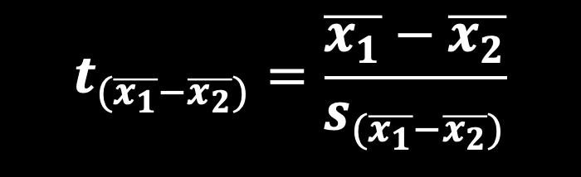

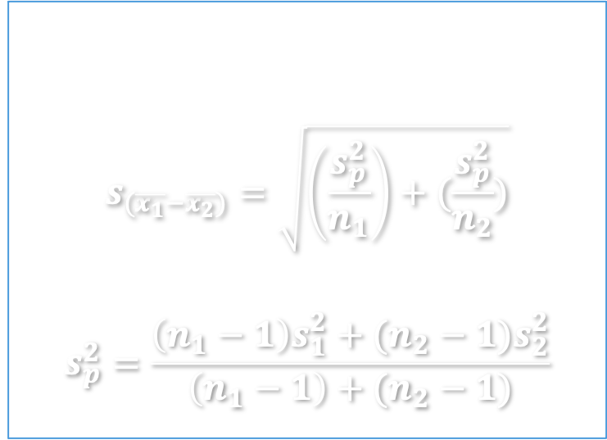
two-means t-test
Two means t-test
Essentially comparing $μ_{1}−μ_{2}$ against hypothesized value 0.
t-score for difference in sample mean:
SE based on sample SDs
$$s_{(\overline{x_{1}}−\overline{x_{2}})}=\sqrt{\left(\frac{s_{p}^{2}}{n_{1}}\right)+(\frac{s_{p}^{2}}{n_{2}})}$$
$$s_{p}^{2}=\frac{\left(n_{1}−1\right)s_{1}^{2}+(n_{2}−1)s_{2}^{2}}{\left(n_{1}−1\right)+(n_{2}−1)}$$
$$t_{(\overline{x_{1}}−\overline{x_{2}})}=\frac{\overline{x_{1}}−\overline{x_{2}}}{s_{(\overline{x_{1}}−\overline{x_{2}})}}$$

Slide 6

Anova
z-test and t-test: test the association between a binary categorical variable and a continuous variable
E.g. test score between genders, birth weight between birth cohorts
ANOVA (Analysis of variance)
Test whether there are any statistically significant differences between the means of 3 or more independent (unrelated) groups.
$H_{0}: μ_{1}=μ_{2}=μ_{3}=…=μ_{k}=μ$ , where $μ$ is the group mean
$H_{1}:$ At least 2 group means are statistically significantly different from each other

Slide 7
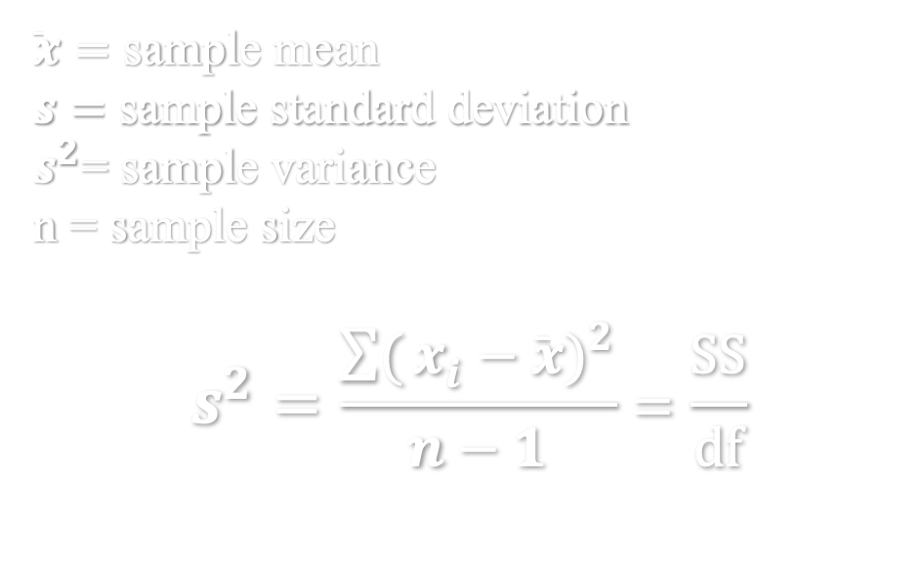
Sample variance
$\overline{x}=$ sample mean
$s=$ sample standard deviation
$s^{2}$= sample variance
n = sample size
$$s^{2}=\frac{\sum{(}{x_{i}−\overline{x})}^{2}}{n−1}=\frac{SS}{df}$$
Hypothesis testing
Testing whether independent variable can explain most of variation in dependent variable
No one-tail vs two-tail option with ANOVA
Sum of squares (SS)
Notes:
SS: how much each value differs from mean.

Slide 8


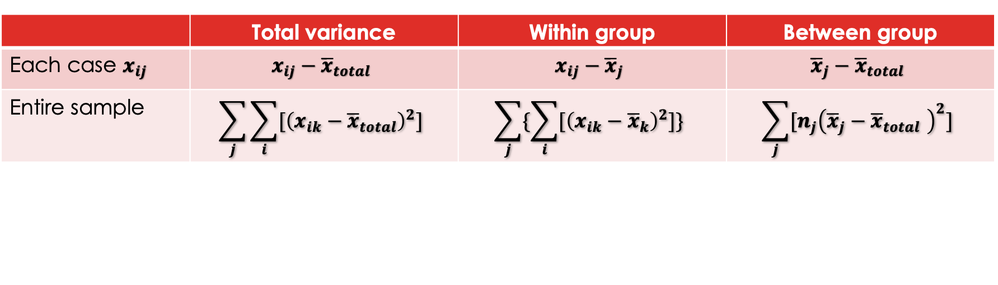
Partitioning variance for DV
 | Total variance | Within group | Between group
Each case $x_{ij}$ | $$x_{ij}−{\overline{x}}_{total}$$ | $$x_{ij}−{\overline{x}}_{j}$$ | $${\overline{x}}_{j}−{\overline{x}}_{total}$$
Entire sample | $$\sum_{j}{\sum_{i}{{[\left(x_{ik}−{\overline{x}}_{total}\right)}^{2}]}}$$ | $$\sum_{j}{\{\sum_{i}{{[\left(x_{ik}−{\overline{x}}_{k}\right)}^{2}]\}}}$$ | $$\sum_{j}{{[n_{j}\left({\overline{x}}_{j}−{\overline{x}}_{total} \right)}^{2}]}$$
$${SS}_{total} = {SS}_{within} + {SS}_{between}$$
i denotes the i^{th} case in a group; j denotes the j^{th} group;
Group mean: ${\overline{x}}_{j}$ , mean of all cases in the j^{th} group
Grand mean: ${\overline{x}}_{total}$, mean of all cases from all groups

Slide 9

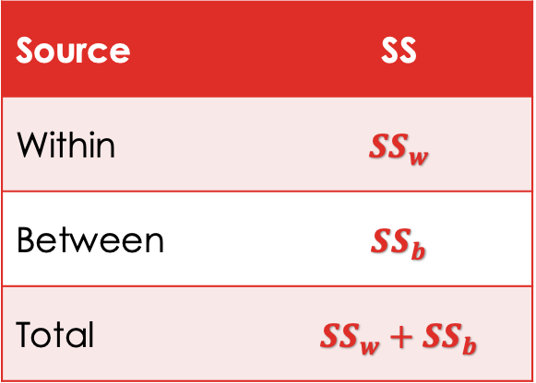
Hypothesis testing
Testing whether independent variable can explain most of variation in dependent variable
Most of total variance ${SS}_{total}$ comes from ${SS}_{within}$, there is no sig. association between group (IV) and DV.
Most of total variance ${SS}_{total}$ comes from ${SS}_{between}$, there is sig. association between group (IV) and DV.
Source | SS
Within | $${SS}_{w}$$
Between | $${SS}_{b}$$
Total | $${SS}_{w}+{SS}_{b}$$

Slide 10
Steps for ANOVA
Calculate group mean ${\overline{x}}_{k}$ and grand mean ${\overline{x}}_{total}$
Calculate group mean 𝒙 ̅_𝒌 and grand mean 𝒙 ̅_𝒕𝒐𝒕𝒂𝒍
Calculate between-group variance for each group, sum across all groups to get ${SS}_{between}$
Calculate between-group variance for each group, sum across all groups to get 〖𝑺𝑺〗_𝒃𝒆𝒕𝒘𝒆𝒆𝒏
Calculate degree of freedom ${df}_{within}$ , ${df}_{between}$
Calculate degree of freedom 〖𝒅𝒇〗_𝒘𝒊𝒕𝒉𝒊𝒏 , 〖𝒅𝒇〗_𝒃𝒆𝒕𝒘𝒆𝒆𝒏
Calculate within-group variance for each group, sum across all groups to get ${SS}_{within}$
Calculate within-group variance for each group, sum across all groups to get 〖𝑺𝑺〗_𝒘𝒊𝒕𝒉𝒊𝒏
Calculate mean squares ${MS}_{within}$ , ${MS}_{between}$
Calculate mean squares 〖𝑴𝑺〗_𝒘𝒊𝒕𝒉𝒊𝒏 , 〖𝑴𝑺〗_𝒃𝒆𝒕𝒘𝒆𝒆𝒏
Calculate F-score, and compare to critical value F given df and sig. level alpha

Slide 11
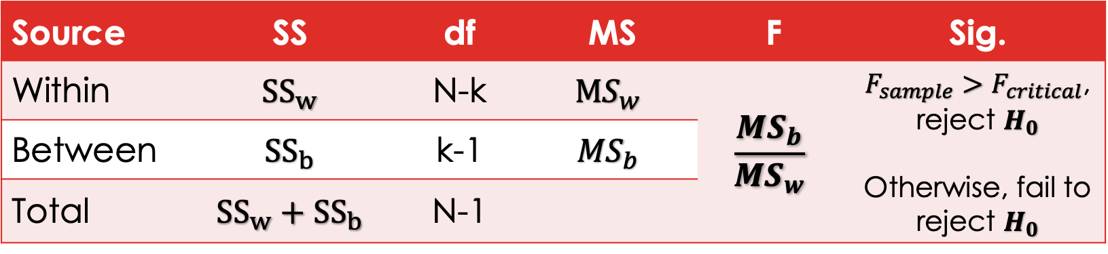
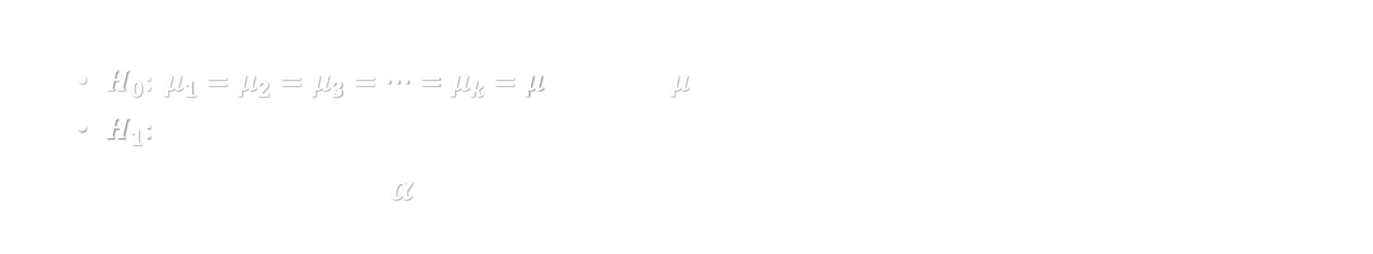
Steps for ANOVA
State hypothesis
$H_{0}: μ_{1}=μ_{2}=μ_{3}=…=μ_{k}=μ$ , where $μ$ is the group mean
$H_{1}:$ At least 2 group means are statistically significantly different from each other
Set significance level, $α$; determine critical value given F-distribution. (Table D)
Source | SS | df | MS | F | Sig.
Within | $${SS}_{w}$$ | N-k | $${MS}_{w}$$ | $$\frac{MS_{b}}{{MS}_{w}}$$ | $F_{sample}>F_{critical}$, reject $H_{0}$ Otherwise, fail to reject $H_{0}$
Between | $${SS}_{b}$$ | k-1 | $${MS}_{b}$$
Total | $${SS}_{w}+{SS}_{b}$$ | N-1

Slide 12

Group mean and grand mean
i denotes the i^{th} case in a group; $(i=1,2,…,n_{j})$
j denotes the j^{th} group; $(j=1,2,…,k)$
Group mean: ${\overline{x}}_{j}$ , mean of all cases in the j^{th} group
$${\overline{x}}_{j}=\frac{x_{1j}+x_{2j}+…+x_{nj}}{n_{j}}$$
Grand mean: ${\overline{x}}_{total}$, mean of all cases from all groups. (total sample size N)
$${\overline{x}}_{total}=\frac{ΣΣx_{ij}}{N}$$

Slide 13
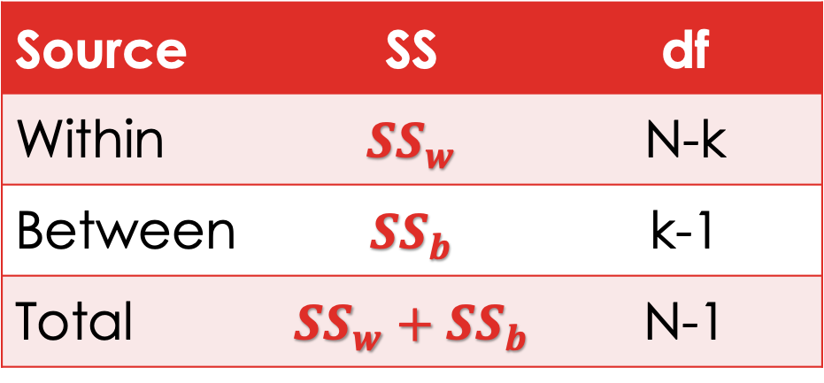
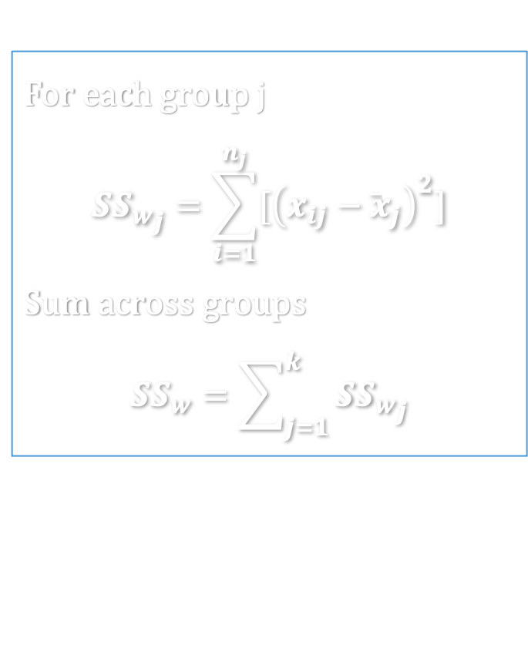
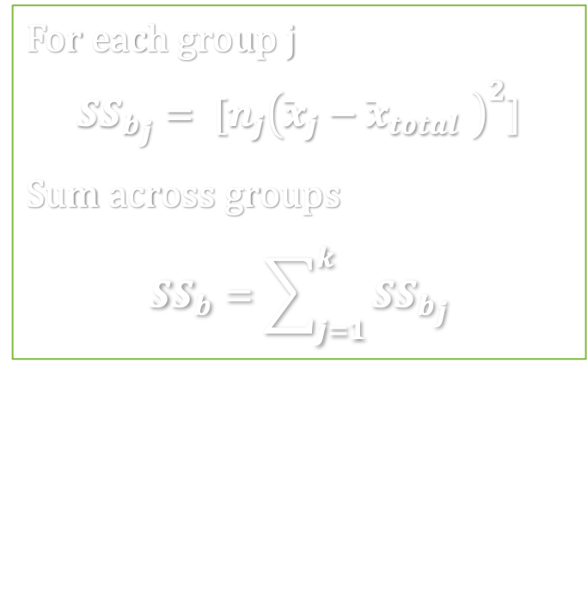
SS and DF
For each group j
$${{SS}_{w}}_{j}=\sum_{i=1}^{n_{j}}{[{\left(x_{ij}−{\overline{x}}_{j}\right)}^{2}]}$$
Sum across groups
$$SS_{w}=\sum_{j=1}^{k}{{{SS}_{w}}_{j}}$$
Source | SS | df
Within | $${SS}_{w}$$ | N-k
Between | $${SS}_{b}$$ | k-1
Total | $${SS}_{w}+{SS}_{b}$$ | N-1
For each group j
$${SS_{b}}_{j}= {[n_{j}\left({\overline{x}}_{j}−{\overline{x}}_{total} \right)}^{2}]$$
Sum across groups
$$SS_{b}=\sum_{j=1}^{k}{{{SS}_{b}}_{j}}$$
N: total sample size
k: total number of groups (categories in IV)

Slide 14
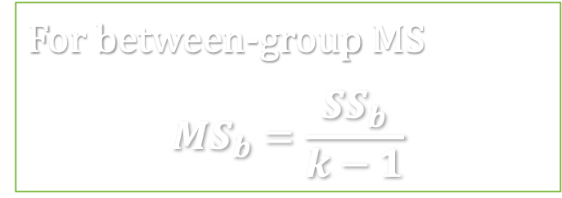
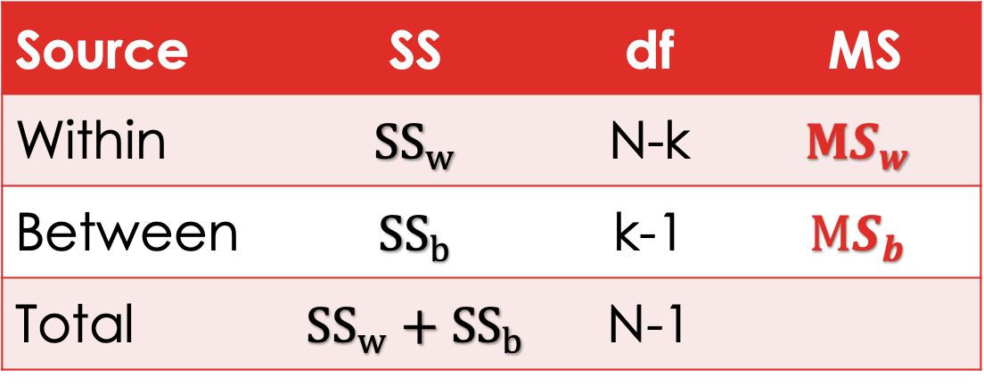
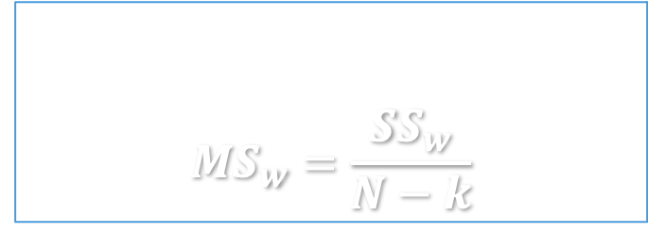
Mean squares
Source | SS | df | MS
Within | $${SS}_{w}$$ | N-k | $${MS}_{w}$$
Between | $${SS}_{b}$$ | k-1 | $${MS}_{b}$$
Total | $${SS}_{w}+{SS}_{b}$$ | N-1
For within-group MS
$${MS}_{w}=\frac{{SS}_{w}}{N−k}$$
For between-group MS
$$MS_{b}=\frac{{SS}_{b}}{k−1}$$
Mean squares takes df into consideration.

Slide 15
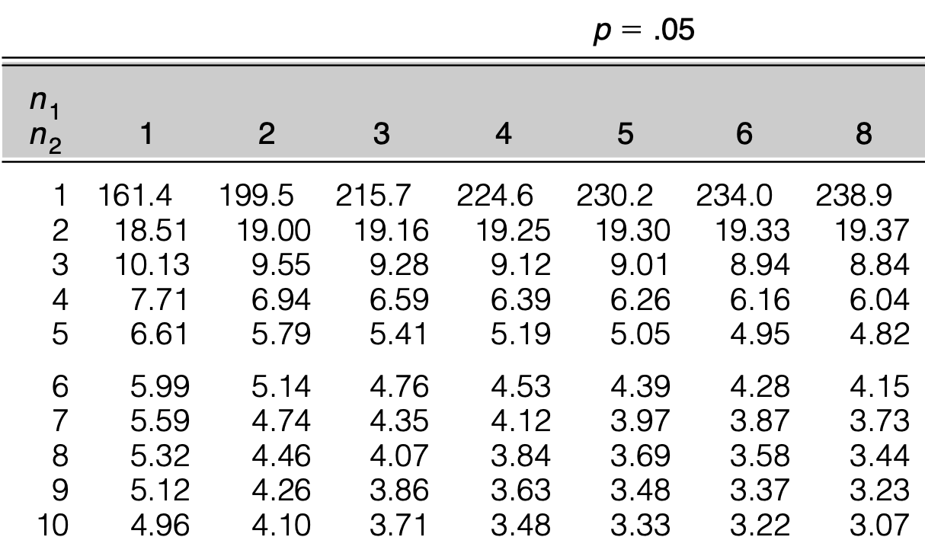

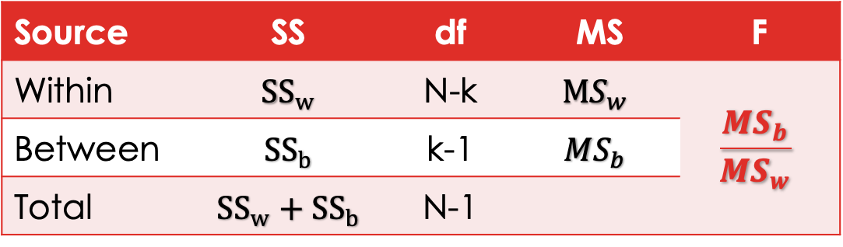
Test statistics and F-distribution
Source | SS | df | MS | F
Within | $${SS}_{w}$$ | N-k | $${MS}_{w}$$ | $$\frac{MS_{b}}{{MS}_{w}}$$
Between | $${SS}_{b}$$ | k-1 | $${MS}_{b}$$
Total | $${SS}_{w}+{SS}_{b}$$ | N-1
F distribution table – Appendix Table D
Separate table for $α=0.05$ and $α=0.01$.
Columns – ${df}_{between}$; Row $− {df}_{within}$
Find critical value given df and $α$
If df falls between listed values, use the one with smaller df.

Slide 16

conclusion
Testing whether independent variable can explain most of variation in dependent variable
$F_{sample}=\frac{MS_{b}}{{MS}_{w}}>F_{critical}=F_{(α, df_{b},df_{w})}$
We reject $H_{0}$, and conclude at least two group means are statistically significantly different.
But we cannot tell which two… need further analysis (e.g. pair-wise t-test)
$F_{sample}=\frac{MS_{b}}{{MS}_{w}}≤F_{critical}=F_{(α, df_{b},df_{w})}$
We fail to reject $H_{0}$, and conclude there is no statistically significant difference between group means.
Notes:
Most of total variance ${SS}_{total}$ comes from ${SS}_{between}$
Most of total variance ${SS}_{total}$ comes from ${SS}_{within}$

Slide 17

Strength of association
$$η^{2}=\frac{SS_{between}}{{SS}_{total}}$$
Measures proportion of total variation that is explained by IV
Judgement of weak or strong is context- or subject-specific
Rule of thumb (guideline)
<10% weak; 10-25% moderate; >25% strong

Slide 18
example
One-way ANOVA

Slide 19

EXAMPLE – anova
GRE example:
ETS wants to know whether students‘ performance in GRE verbal tests is associated with race/ethnicity among US citizens in 2012. ($α=0.05$)
 | Sample size | Sample Mean | Sample SD
1 - White | 100 | 154.1 | 7.3
2 - African-American | 100 | 146.7 | 7.1
3 - Asian | 100 | 152.6 | 8.0
N: total sample size, N=100+100+100=300
k: total number of groups (categories in IV), k=3
Q: How can you get SS without knowing score for every student?
Notes:
Data made up basted on ETS 2012 report https://www.ets.org/s/gre/pdf/snapshot.pdf

Slide 20

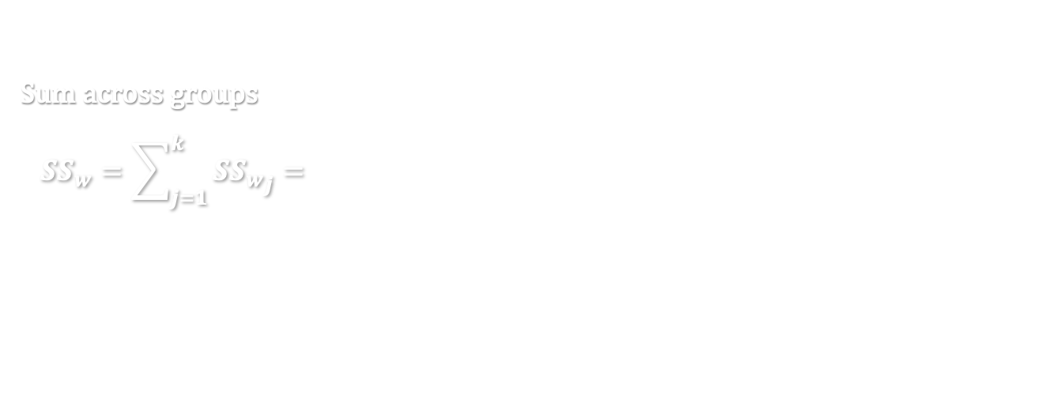
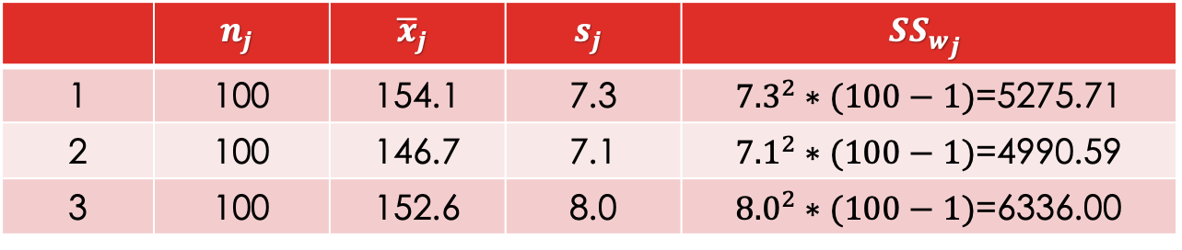
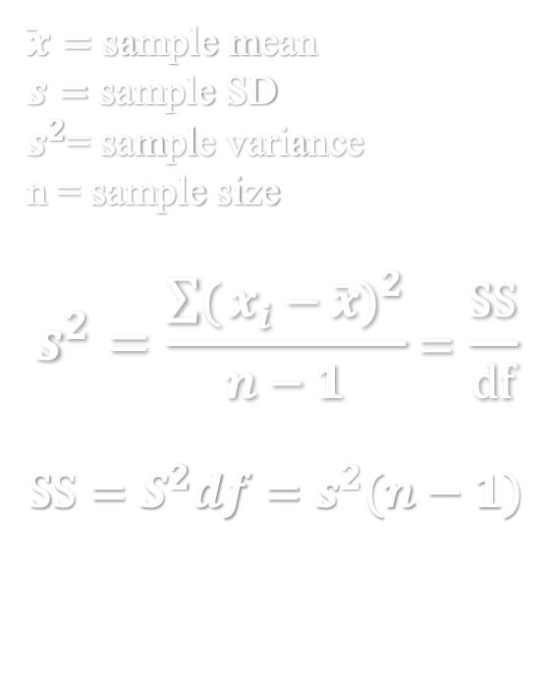
$$SS_{within}$$
$\overline{x}=$ sample mean
$s=$ sample SD
$s^{2}$= sample variance
n = sample size
$$s^{2}=\frac{\sum{(}{x_{i}−\overline{x})}^{2}}{n−1}=\frac{SS}{df}$$
$$SS=S^{2}df=s^{2}(n−1)$$
 | $$n_{j}$$ | $${\overline{x}}_{j}$$ | $$s_{j}$$ | $${{SS}_{w}}_{j}$$
1 | 100 | 154.1 | 7.3 | ${7.3}^{2}∗(100−1)$=5275.71
2 | 100 | 146.7 | 7.1 | ${7.1}^{2}∗(100−1)$=4990.59
3 | 100 | 152.6 | 8.0 | ${8.0}^{2}∗(100−1)$=6336.00
Sum across groups
$$SS_{w}=\sum_{j=1}^{k}{{{SS}_{w}}_{j}}={7.3}^{2}∗\left(100−1\right)+{7.1}^{2}∗\left(100−1\right)+{8.0}^{2}∗\left(100−1\right)=5275.71+4990.59+6336.00=16602.3$$

Slide 21
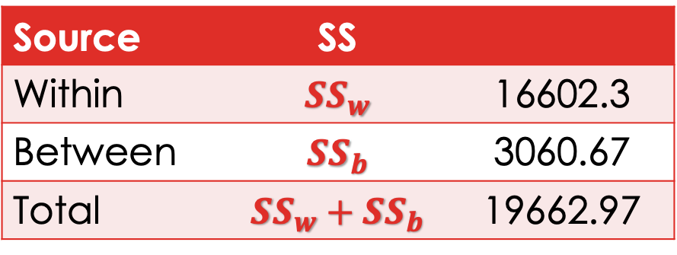
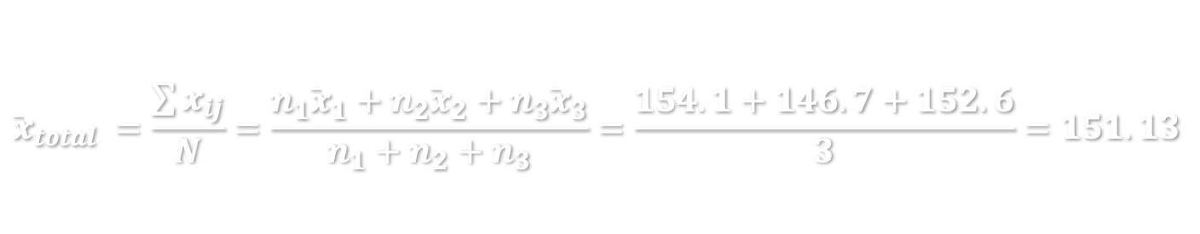
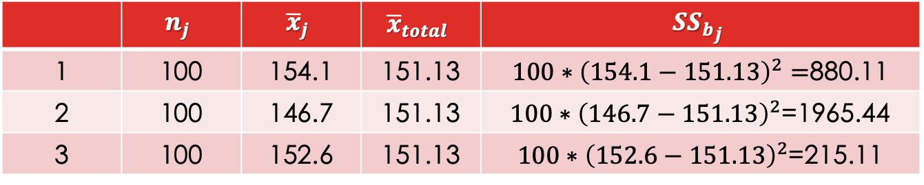
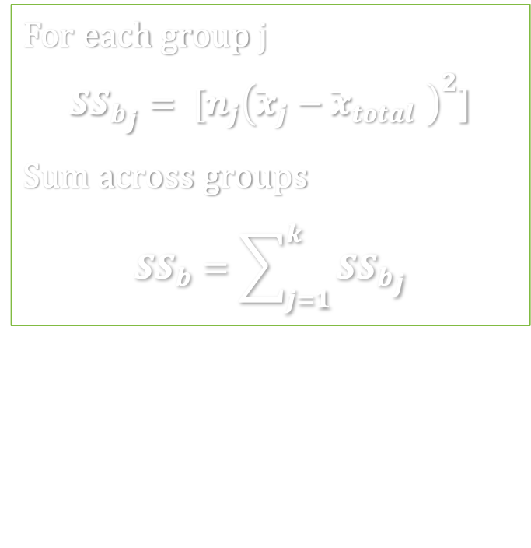
SS
For each group j
$${SS_{b}}_{j}= {[n_{j}\left({\overline{x}}_{j}−{\overline{x}}_{total} \right)}^{2}]$$
Sum across groups
$$SS_{b}=\sum_{j=1}^{k}{{{SS}_{b}}_{j}}$$
Source | SS
Within | $${SS}_{w}$$ | 16602.3
Between | $${SS}_{b}$$ | 3060.67
Total | $${SS}_{w}+{SS}_{b}$$ | 19662.97
 | $$n_{j}$$ | $${\overline{x}}_{j}$$ | $${\overline{x}}_{total}$$ | $${{SS}_{b}}_{j}$$
1 | 100 | 154.1 | 151.13 | $100∗{\left(154.1−151.13\right)}^{2}=$880.11
2 | 100 | 146.7 | 151.13 | $100∗{\left(146.7−151.13\right)}^{2}$=1965.44
3 | 100 | 152.6 | 151.13 | $100∗{\left(152.6−151.13\right)}^{2}$=215.11
$${\overline{x}}_{total} =\frac{\sum{x_{ij}}}{N}=\frac{n_{1}{\overline{x}}_{1}+n_{2}{\overline{x}}_{2}+n_{3}{\overline{x}}_{3}}{n_{1}+n_{2}+n_{3}}=\frac{154.1+146.7+152.6}{3}=151.13$$

Slide 22
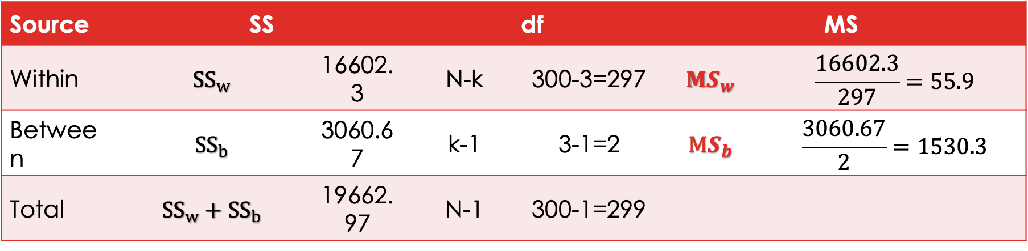
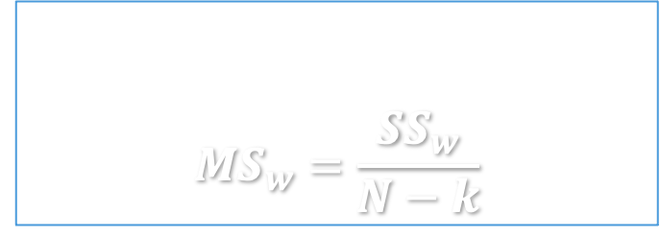
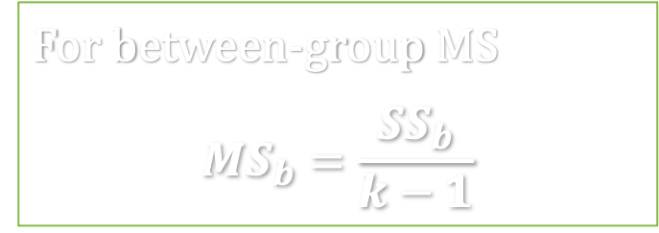
DF, MS
Source | SS |  | df |  | MS
Within | $${SS}_{w}$$ | 16602.3 | N-k | 300-3=297 | $${MS}_{w}$$ | $$\frac{16602.3}{297}=55.9$$
Between | $${SS}_{b}$$ | 3060.67 | k-1 | 3-1=2 | $${MS}_{b}$$ | $$\frac{3060.67}{2}=1530.3$$
Total | $${SS}_{w}+{SS}_{b}$$ | 19662.97 | N-1 | 300-1=299
For within-group MS
$${MS}_{w}=\frac{{SS}_{w}}{N−k}$$
For between-group MS
$$MS_{b}=\frac{{SS}_{b}}{k−1}$$
Notes:
55.90000 1530.33333 65.76243

Slide 23
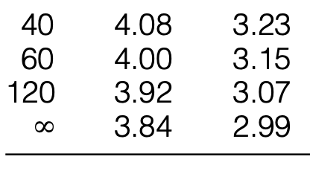


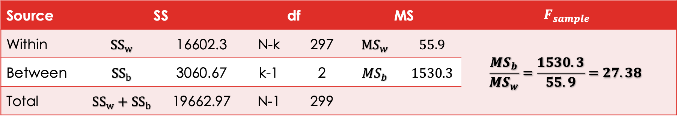
$f_{critical}$and $F_{sample}$
F distribution table – Appendix Table D
Critical value $F_{critical}$
$α=0.05$; Column ${df}_{b}=2$, Row${df}_{w}=297$
Test statistics $F_{sample}$
Source | SS |  | df |  | MS |  | $$F_{sample}$$
Within | $${SS}_{w}$$ | 16602.3 | N-k | 297 | $${MS}_{w}$$ | $$55.9$$ | $$\frac{MS_{b}}{{MS}_{w}}=\frac{1530.3}{55.9}=27.38$$
Between | $${SS}_{b}$$ | 3060.67 | k-1 | 2 | $${MS}_{b}$$ | $$1530.3$$
Total | $${SS}_{w}+{SS}_{b}$$ | 19662.97 | N-1 | 299

Slide 24

conclusion
$F_{sample}=\frac{MS_{b}}{{MS}_{w}}>F_{critical}=F_{(α, df_{b},df_{w})}$
Most of total variance ${SS}_{total}$ comes from ${SS}_{between}$
We reject $H_{0}$, and conclude that at least two race groups have mean GRE verbal test scores that are statistically significantly different.
Strength of association
$$η^{2}=\frac{SS_{between}}{{SS}_{total}}=\frac{3060.67}{19662.97}=15.6\%$$
15.6% of total variation in GRE test score is explained by race/ethnicity groups, the association between race and GRE performance is moderately strong.

Slide 25

In-class exercise
COVID example
For selected county of residence, the number of COVID cases per 100 million population:
Question
Does the 3 states have similar COVID prevalence?
Use ANOVA test to test your hypothesis at significant level $α$= 0.05
Write down your summary ANOVA table (as the one on slide #11)
Upload your answer in Carmen – Lab attendance
OH | 2.6 | 2.7 | 3.1 | 3.2 | 2.3 | 2.7 | 3.0 | 3.2
NY | 1.9 | 3.6 | 4.0 | 6.0 | 4.5 | 3.9 | 2.1 | 1.9
MD | 1.8 | 2.7 | 3.9 | 1.9 | 2.8 | 3.4 | 2.8 | 1.5
Notes:
https://covid.cdc.gov/covid-data-tracker/#county-map

